Slide 1
CSS
MCNDHS
Ms. Eng

Slide 2
aim: How do we define classes?
Do now:
Daily Grade:
On-time/attendance/not leaving the classroom: 25%
Cellphones: 25%
Notes:25%
Classwork/Homework: 25%

Slide 3


before:
We focused on ID’s

Slide 4
disadvantages:
What if we want to use a SPECIFIC effect to an element within our ID?
ID’s affect the ENTIRE element

Slide 5
classes:
html:
type out element, followed by class=“ “.
example:
<div class=“hello”>
<p class=“hello”>sldjfskljfkdls</p>
</div>
css:
to affect everything:
.hello{
}
to affect certain items:
p.hello{
}

Slide 6
very important
You can ONLY target INLINE elements.
If you want to change block elements, don’t mention the class.

Slide 7
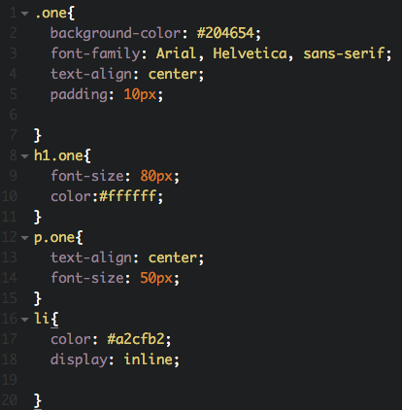
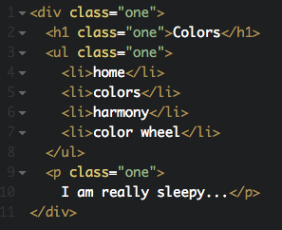
example:

Slide 8

activity:

